Slide 1
Lesson 5
Working with Bootstrap
ST0501
Front End Web Development

Slide 2

Lesson 5 Part 2 : Grid and How to Use Them
“A website using a 12-column grid”

Slide 3
The Bootstrap Grid System
Bootstrap includes a responsive, mobile first grid system that can have up to 12 columns in a design.
And the columns are designed to respond to the width of the device and scale up and down appropriately.
Make sure that the sum adds up to 12 or fewer (it is not required that you use all 12 available columns)

Slide 4
Grid Classes
The Bootstrap 5 grid system has six classes:
.col- (extra small devices - screen width less than 576px eg. portrait phones)
.col-sm- (small devices - screen width equal to or greater than 576px eg. landscape phones)
.col-md- (medium devices - screen width equal to or greater than 768px eg. tablets)
.col-lg- (large devices - screen width equal to or greater than 992px eg. desktops)
.col-xl- (xlarge devices - screen width equal to or greater than 1200px eg. large desktops)
.col-xxl- (xxlarge devices - screen width equal to or greater than 1400px)
The classes above can be combined to create more dynamic and flexible layouts.
Tip: Each class scales up, so if you wish to set the same widths for sm and md, you only need to specify sm.

Slide 5
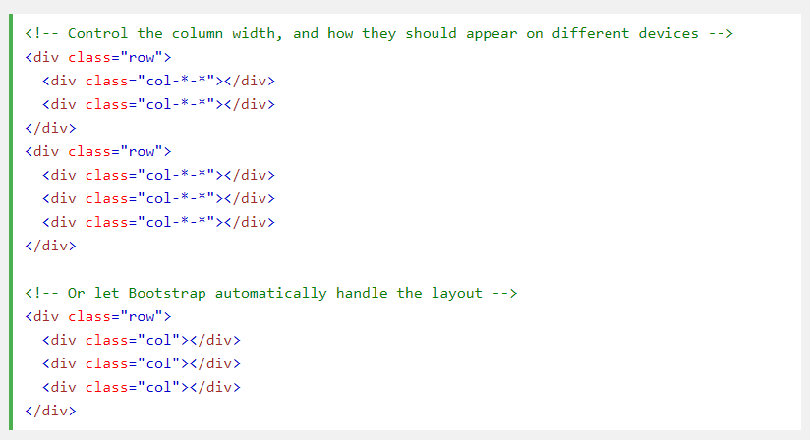
Basic Structure of a Bootstrap 5 Grid
Notes:
First example: create a row (<div class="row">). Then, add the desired number of columns (tags with appropriate .col-*-* classes). The first star (*) represents the responsiveness: sm, md, lg or xl, while the second star represents a number, which should add up to 12 for each row.
Second example: instead of adding a number to each col, let bootstrap handle the layout, to create equal width columns: two "col" elements = 50% width to each col. three cols = 33.33% width to each col. four cols = 25% width, etc. You can also use .col-sm|md|lg|xl to make the columns responsive.

Slide 6
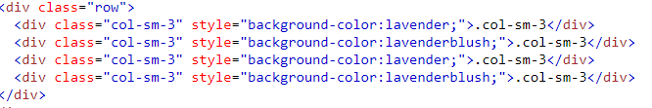
Responsive Columns
The following example shows how to create four equal-width columns starting at tablets and scaling to extra large desktops. On mobile phones or screens that are less than 576px wide, the columns will automatically stack on top of each other
Notes:
You may demo and get the students to try.

Slide 7
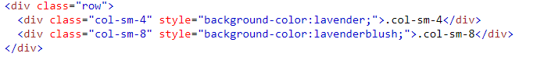
Two Unequal Responsive Columns
The following example shows how to get two various-width columns starting at tablets and scaling to large extra desktops:
Notes:
You may demo and get the students to try.

Slide 8
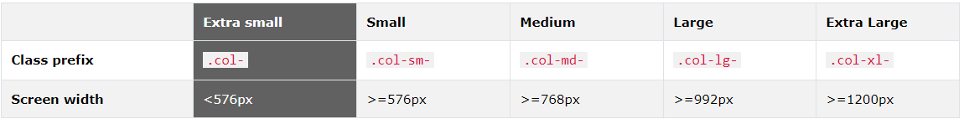
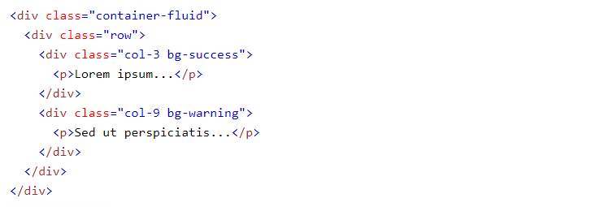
Assume we have a simple layout with two columns. We want the columns to split 25%/75% for ALL devices.
We will add the following classes to our two columns:
Notes:
You may demo and get the students to try.

Slide 9
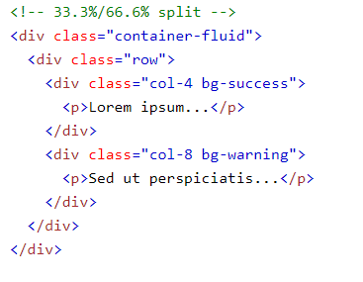
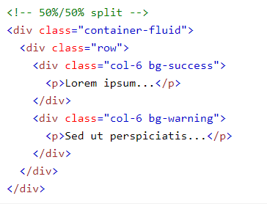
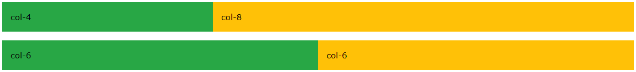
For a 33.3%/66.6% split, you would use .col-4 and .col-8 (and for a 50%/50% split, you would use .col-6 and .col-6):
Notes:
You may demo and get the students to try.

Slide 10
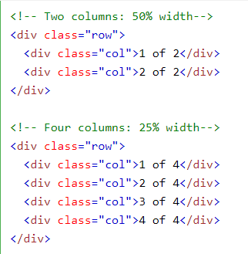
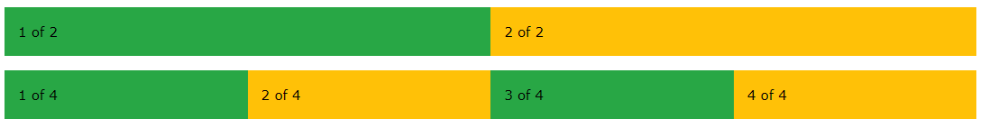
In Bootstrap 5, there is an easy way to create equal width columns for all devices: just remove the number from .col-* and only use the .col class on a specified number of col elements. Bootstrap will recognize how many columns there are, and each column will get the same width:
Notes:
You may demo and get the students to try.

Slide 11
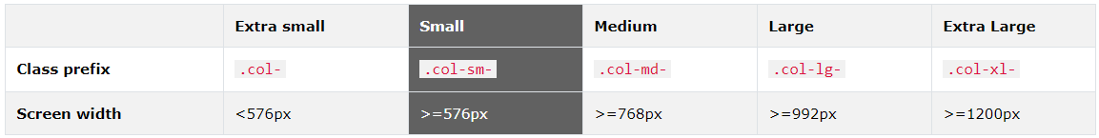
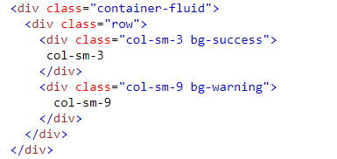
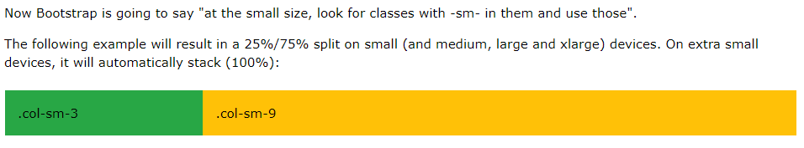
Assume we have a simple layout with two columns. We want the columns to be split 25%/75% for small devices. We will add the following classes to our two columns:
Notes:
You may demo and get the students to try.

Slide 12
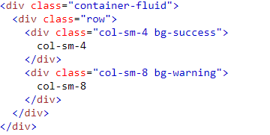
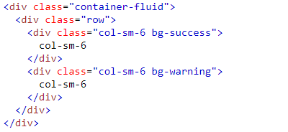
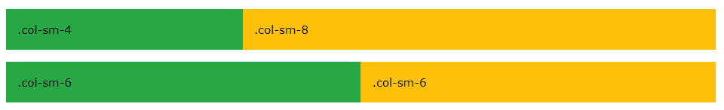
For a 33.3%/66.6% split, you would use .col-sm-4 and .col-sm-8 (and for a 50%/50% split, you would use .col-sm-6 and .col-sm-6):
Notes:
You may demo and get the students to try.

Slide 13
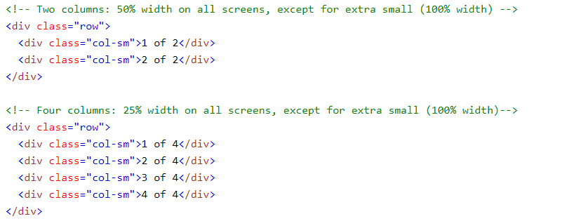
In Bootstrap, there is an easy way to create equal width columns for all devices: just remove the number from .col-sm-* and only use the .col-sm class on a specified number of col elements. Bootstrap will recognize how many columns there are, and each column will get the same width.
If the screen size is less than 576px, the columns will stack horizontally:
Notes:
You may demo and get the students to try.

Slide 14
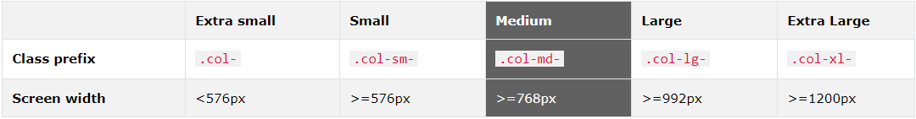
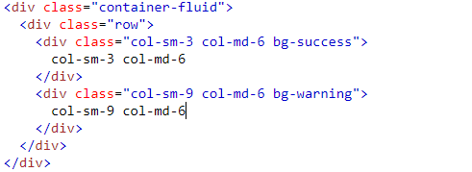
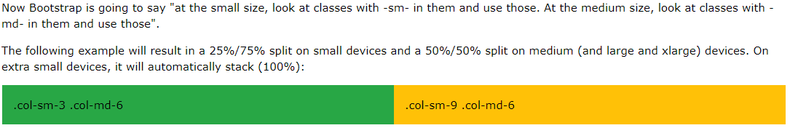
In the previous chapter, we presented a grid example with classes for small devices. We used two divs (columns) and we gave them a 25%/75% split. But on medium devices the design may be better as a 50%/50% split.. For medium devices we will use the .col-md-* classes:
Notes:
You may demo and get the students to try.

Slide 15
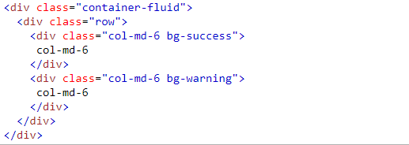
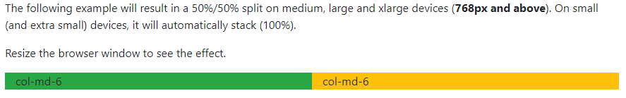
In the example below, we only specify the .col-md-6 class (without .col-sm-*). This means that medium, large and extra large devices will split 50%/50% - because the class scales up. However, for small and extra small devices, it will stack vertically (100% width):
Notes:
You may demo and get the students to try.

Slide 16
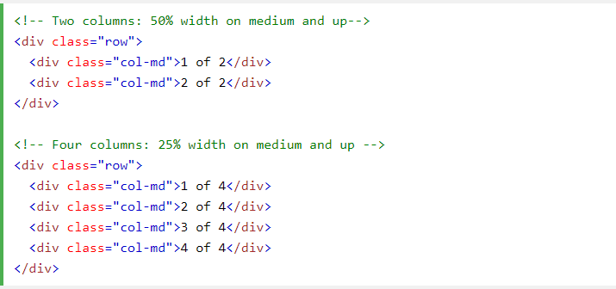
In Bootstrap, there is an easy way to create equal width columns for all devices: just remove the number from .col-md-* and only use the .col-md class on a specified number of col elements. Bootstrap will recognize how many columns there are, and each column will get the same width.
If the screen size is less than 768px, the columns will stack horizontally:
Notes:
You may demo and get the students to try.

Slide 17
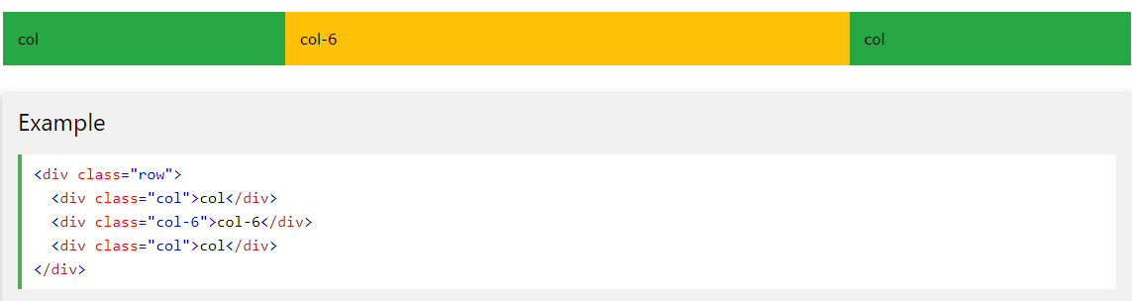
Setting One Column Width
However, it is enough to only set the width of one column, and have the sibling columns automatically resize around it. The following example will create a 25%/50%/25% split:
Notes:
You may demo and get the students to try.

Slide 18
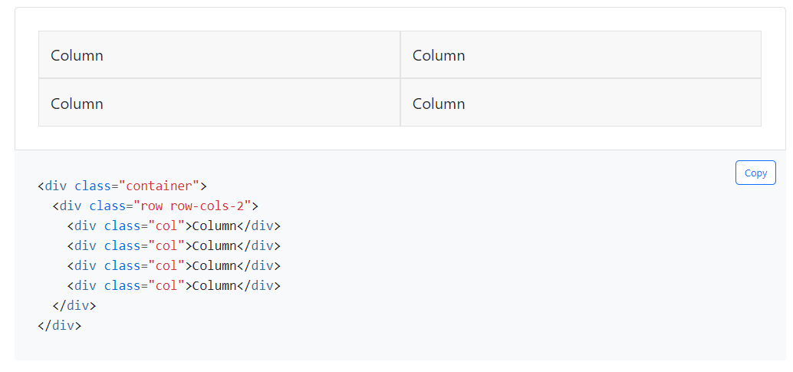
Row Columns
Use the responsive .row-cols-* classes to quickly set the number of columns that best render your content and layout. Whereas normal .col-* classes apply to the individual columns (e.g., .col-md-4), the row columns classes are set on the parent .row as a default for contained columns. With .row-cols-auto you can give the columns their natural width.
Notes:
You may demo and get the students to try.

Slide 19
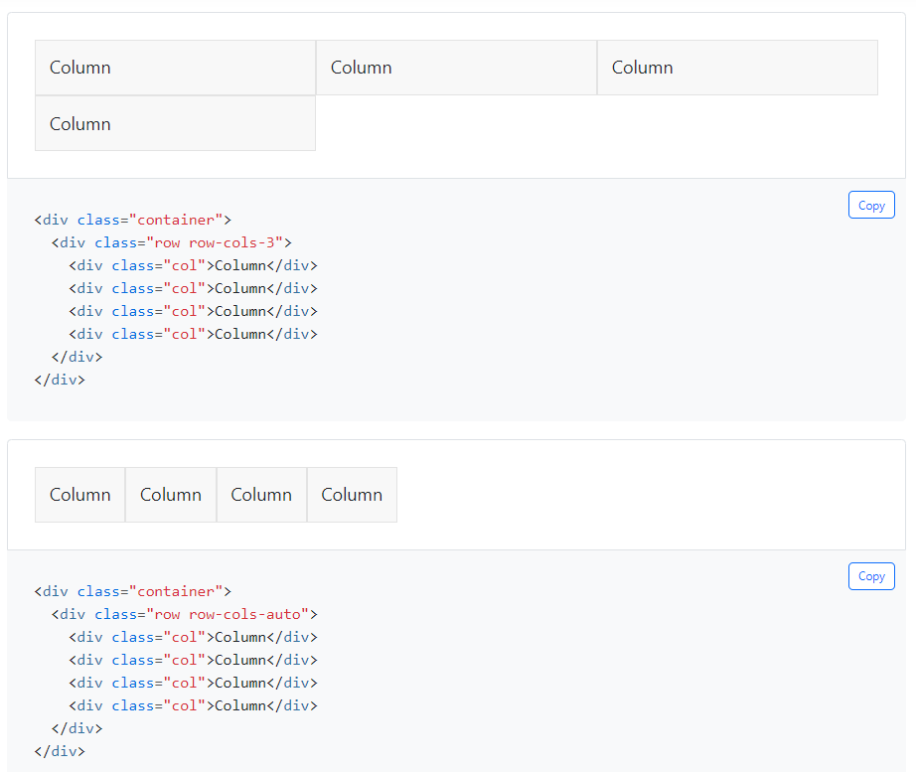
Row Columns
Notes:
You may demo and get the students to try.

Slide 20
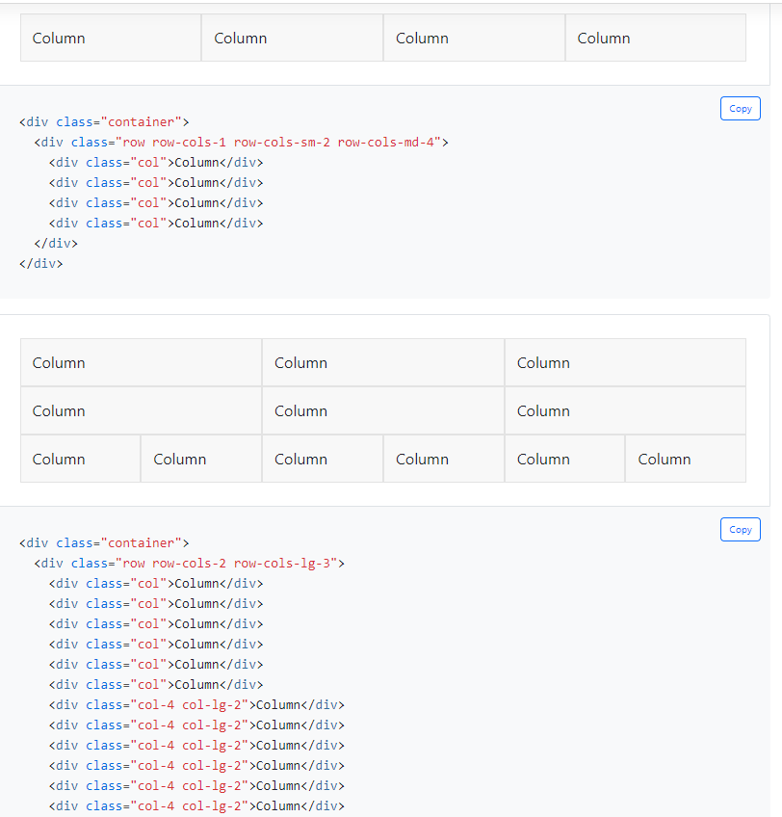
Row Columns
Notes:
You may demo and get the students to try.

Slide 21
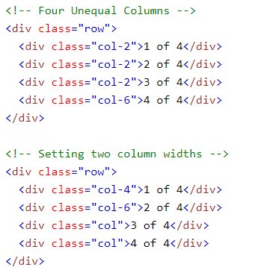
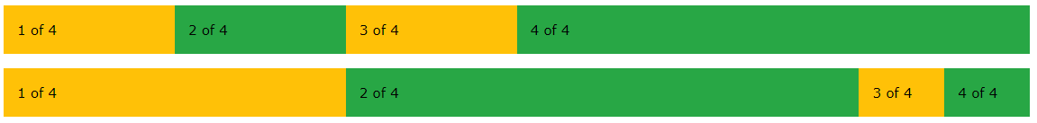
More Unequal Columns
Notes:
You may demo and get the students to try.

Slide 22
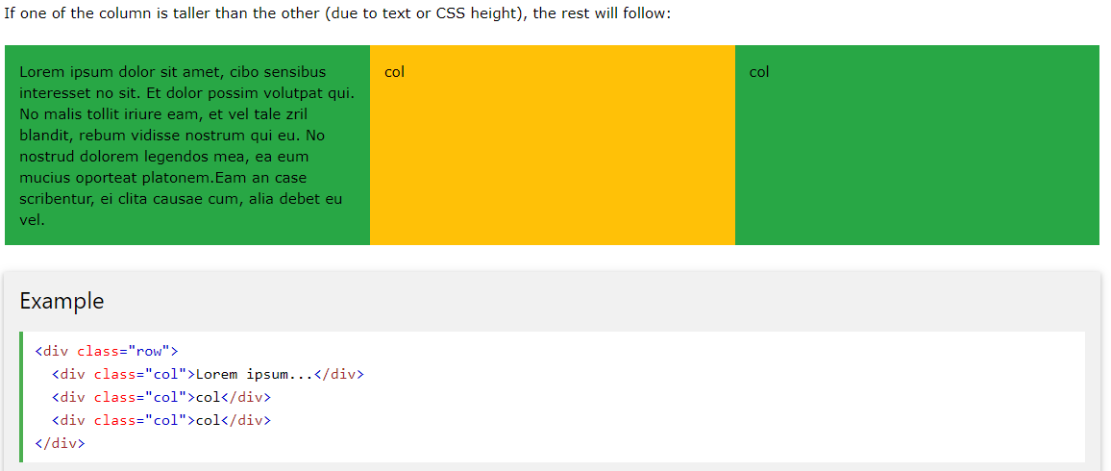
Equal Height
Notes:
You may demo and get the students to try.

Slide 23
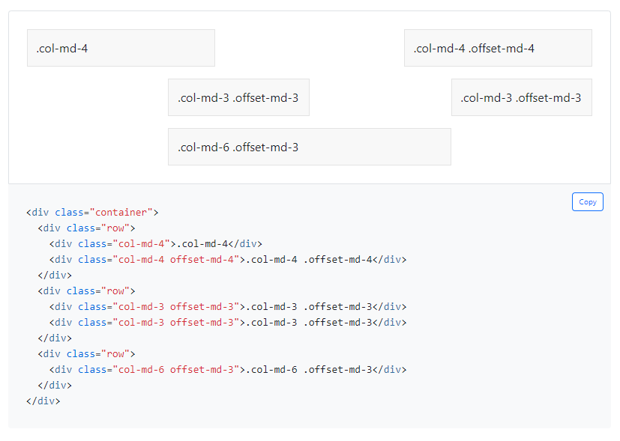
Offset Classes
Move columns to the right using .offset-md-* classes. These classes increase the left margin of a column by * columns. For example, .offset-md-4 moves .col-md-4 over four columns.
Notes:
You may demo and get the students to try.

Slide 24
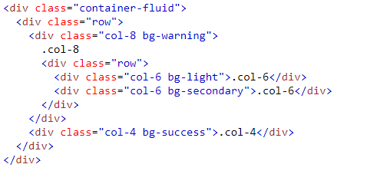
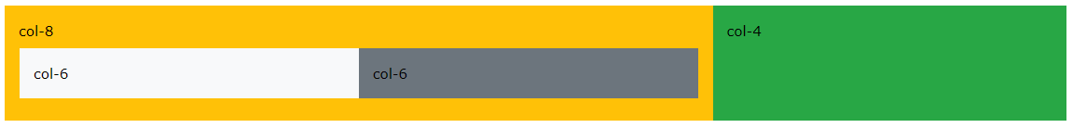
Nesting Columns
The following example shows how to create a two column layout, with another two columns inside one of the columns:
Notes:
You may demo and get the students to try.

Slide 25
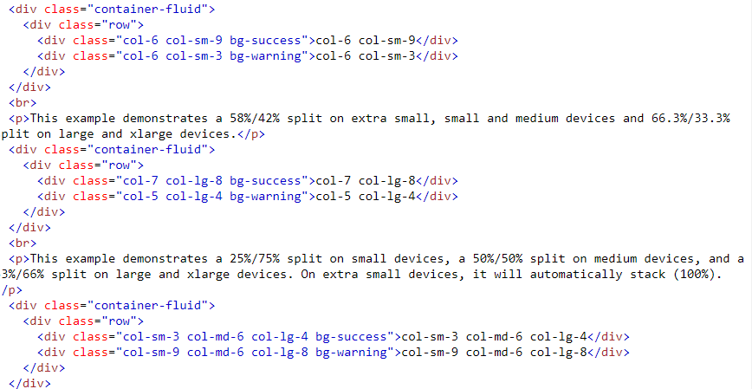
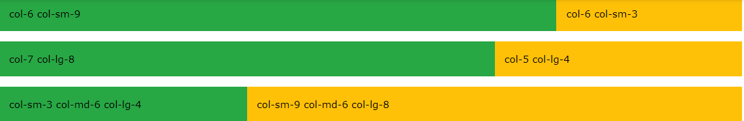
More Mix and Match
Notes:
You may demo and get the students to try.

Slide 26
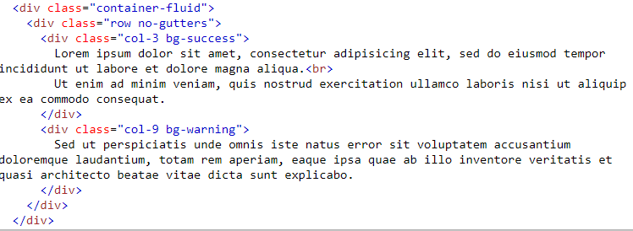
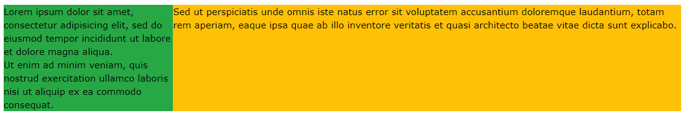
No Gutters
Add the .no-gutters class to the .row container to remove gutters (extra space):
Notes:
You may demo and get the students to try.

Slide 27
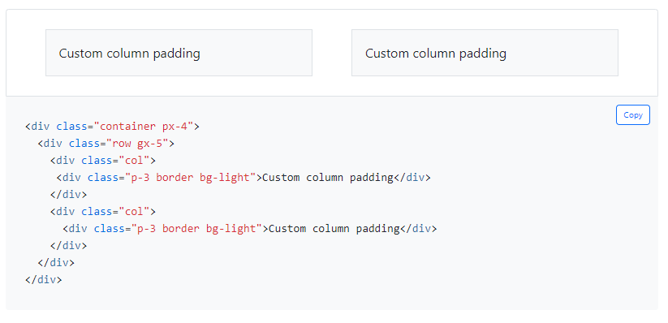
Gutters
Gutters are the padding between your columns, used to responsively space and align content in the Bootstrap grid system.
Horizontal gutters: .gx-* classes can be used to control the horizontal gutter widths. The .container or .container-fluid parent may need to be adjusted if larger gutters are used too to avoid unwanted overflow, using a matching padding utility. For example, in the following example we’ve increased the padding with .px-4:
Notes:
You may demo and get the students to try.

Slide 28
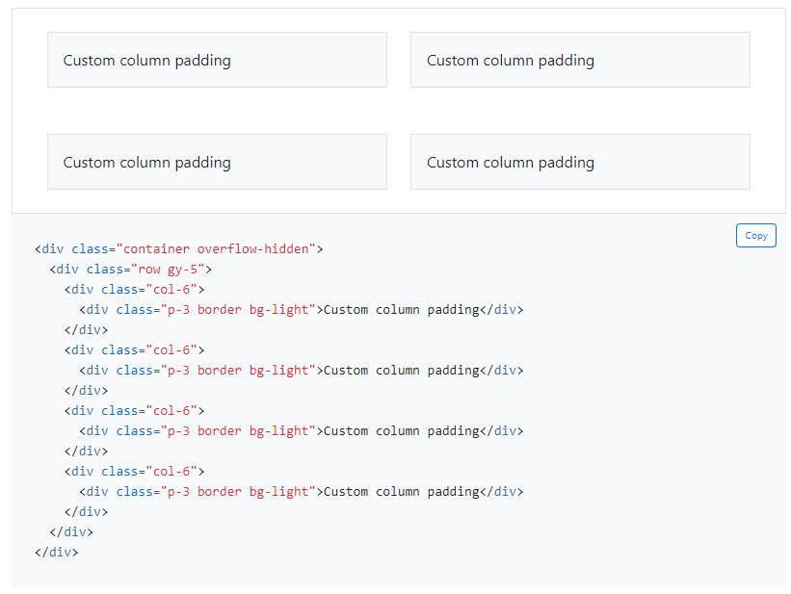
Gutters
.gy-* classes can be used to control the vertical gutter widths. Like the horizontal gutters, the vertical gutters can cause some overflow below the .row at the end of a page. If this occurs, you add a wrapper around .row with the .overflow-hidden class:
Notes:
You may demo and get the students to try.

Slide 29
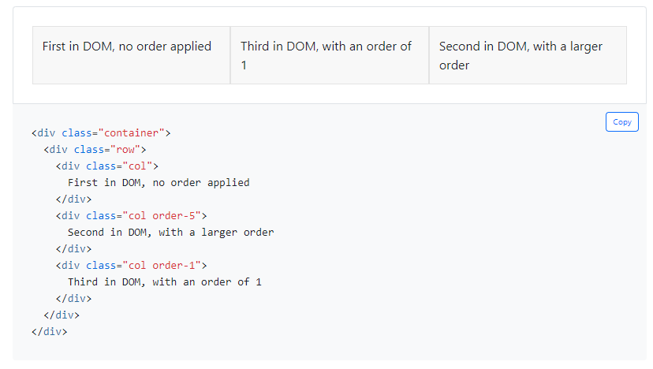
Reordering – Order classes
Use .order- classes for controlling the visual order of your content. These classes are responsive, so you can set the order by breakpoint (e.g., .order-1.order-md-2). Includes support for 1 through 5 across all six grid tiers.
Notes:
You may demo and get the students to try.

Slide 30
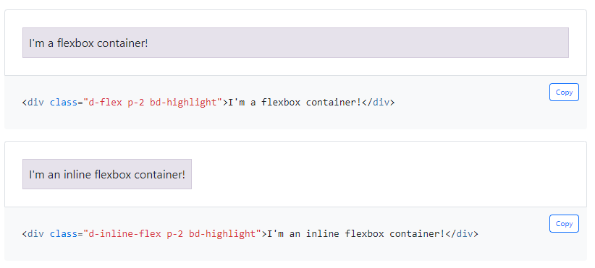
Flex - Enable flex behaviors
Apply display utilities to create a flexbox container and transform direct children elements into flex items. Flex containers and items are able to be modified further with additional flex properties.
Notes:
You may demo and get the students to try.

Slide 31
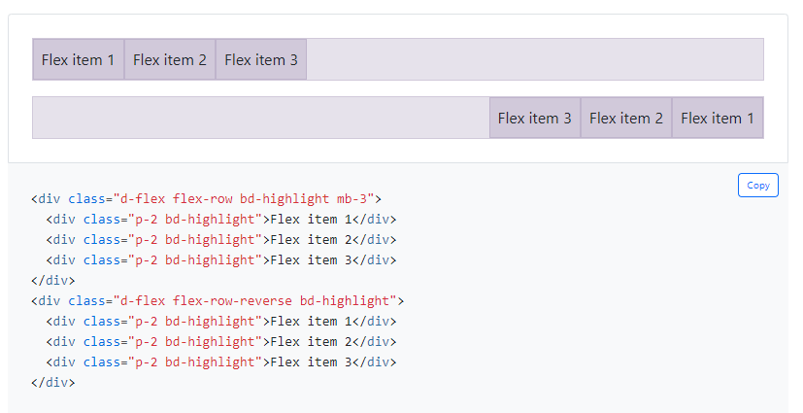
Flex - Directions
Set the direction of flex items in a flex container with direction utilities. In most cases you can omit the horizontal class here as the browser default is row. However, you may encounter situations where you needed to explicitly set this value (like responsive layouts).
Use .flex-row to set a horizontal direction (the browser default), or .flex-row-reverse to start the horizontal direction from the opposite side.
Notes:
You may demo and get the students to try.

Slide 32
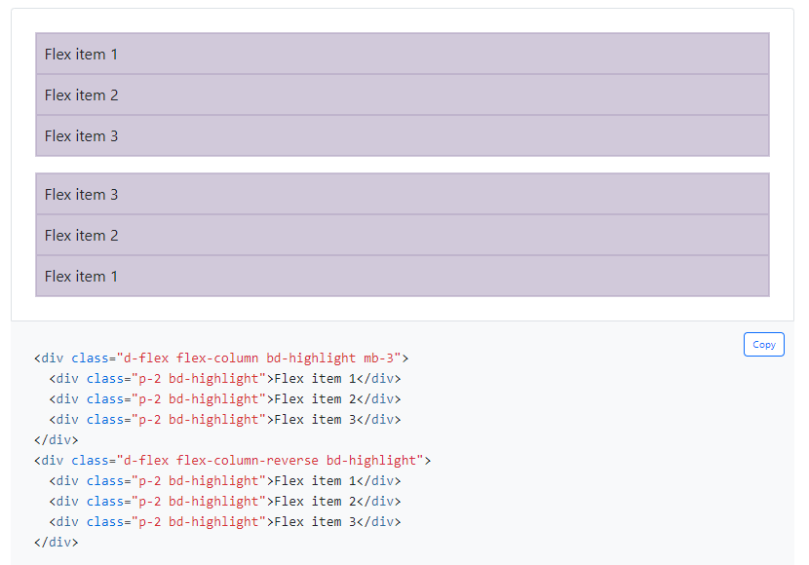
Flex - Directions
Use .flex-column to set a vertical direction, or
.flex-column-reverse to start the vertical direction from the opposite side.
Notes:
You may demo and get the students to try.

Slide 33
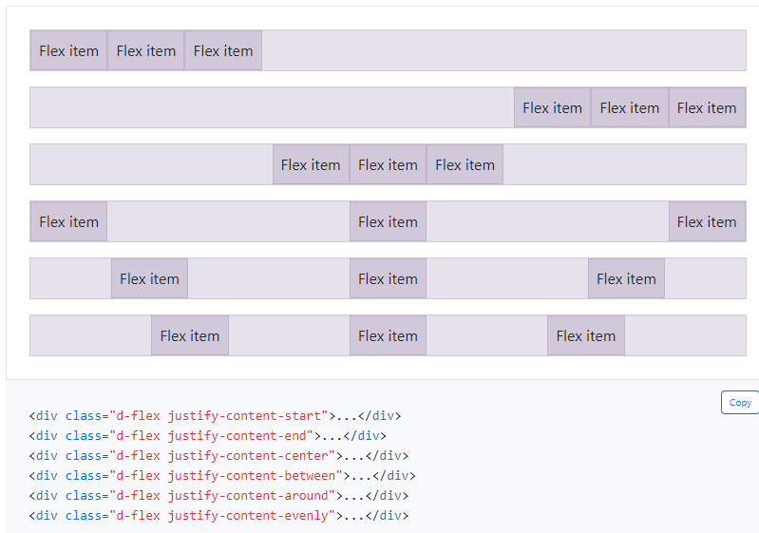
Flex Alignment – Justify Content
Use justify-content utilities on flexbox containers to change the alignment of flex items on the main axis (the x-axis to start, y-axis if flex-direction: column). Choose from start (browser default), end, center, between, around, or evenly.
Notes:
You may demo and get the students to try.

Slide 34
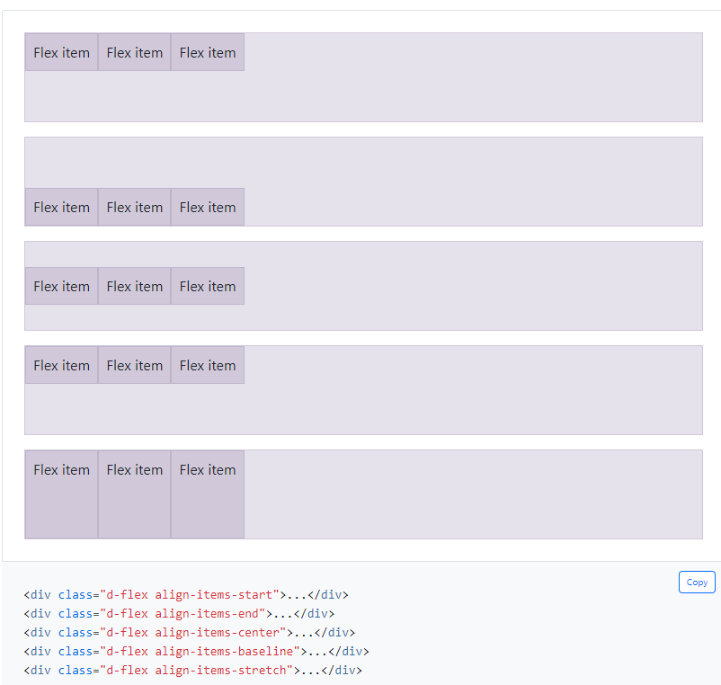
Flex Alignment – Align Items
Use align-items utilities on flexbox containers to change the alignment of flex items on the cross axis (the y-axis to start, x-axis if flex-direction: column). Choose from start, end, center, baseline, or stretch (browser default).
Notes:
You may demo and get the students to try.

Slide 35

Thank
You

